Slide 1


JOB CHECK
DETECTING FAKE JOB POSTS
Page 01

Slide 2

Team Members
B. Hari Priya
V. Shakthi Sarvanan
CH. Harshapriya
Athul S
Page 02

Slide 3
Objective :
The objective of this project is to develop an intelligent system using Natural Language Processing (NLP) and Machine Learning (ML) techniques to automatically detect and classify job postings as real or fake.
The system leverages text-based features from job descriptions and user feedback to continuously improve its prediction accuracy, helping users identify fraudulent job postings efficiently.
Page 03

Slide 4
Dataset Overview
Source: Kaggle - Job Detection Dataset
Size: 25,788 job postings
Features: 10 attributes describing job details (e.g., title, description, requirements, company profile, benefits, industry).
Page 04

Slide 5
Libraries
Streamlit – For creating an interactive web app interface
Pandas – For data loading, cleaning, and manipulation
re / os – For text cleaning and file handling
Joblib – For saving and loading trained ML models
Matplotlib & Seaborn – For data visualization and performance plots
train_test_split – Split dataset into training/testing sets
TfidfVectorizer – Convert text to numerical features
LogisticRegression – Machine learning model for text classification
metrics – Evaluate model performance (accuracy, precision, recall,F1)
Page 05

Slide 6
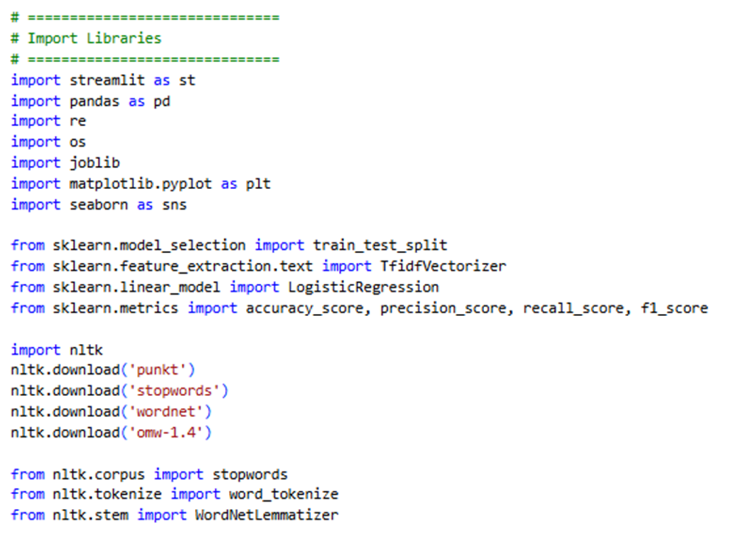
word_tokenize – Split text into words
stopwords – Remove common words
WordNetLemmatizer – Reduce words to base form
Download linguistic datasets (punkt, wordnet, etc.)
Page 06

Slide 7
DATA PREPROCESSING
Dataset Loading :
Uses pandas to read data from an Excel file (Fakejob_dataset.xlsx) Cached using @st.cache_data for faster reloading in Streamlit,Displays a preview of the dataset in the app using st.dataframe().
Text Preprocessing :
Converts text to lowercase. Removes HTML tags, URLs, special characters, and extra spaces
Page 07

Slide 8
Text Cleaning:
Tokenization using word_tokenize()
Removes stopwords and non-alphabetic tokens
Applies lemmatization (WordNetLemmatizer) to reduce words to their root form
Rejoins processed tokens into clean text strings
Page 08

Slide 9
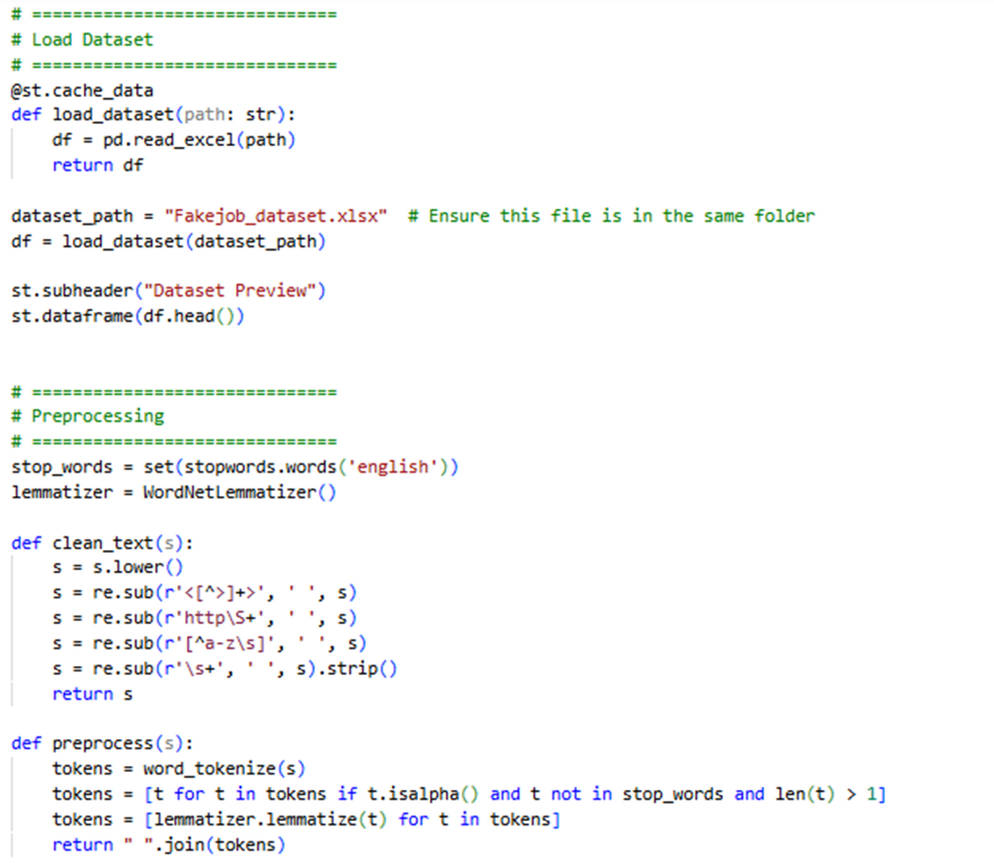
Page 09

Slide 10
MODEL TRAINING
Data Preparation: Combines multiple text columns into one field and applies text cleaning and preprocessing.
Data Splitting: Divides dataset into training (80%) and testing (20%) sets.
Feature Extraction: Converts text into numerical features using TF-IDF Vectorizer.
Model Training: Trains a Logistic Regression classifier on processed text data.
Page 10

Slide 11
Model Evaluation: Measures performance using Accuracy, Precision, Recall, and F1 Score.
Result Display: Shows evaluation metrics in the Streamlit app interface.
Caching: Uses @st.cache_resource to speed up model training and reuse.
Page 11

Slide 12
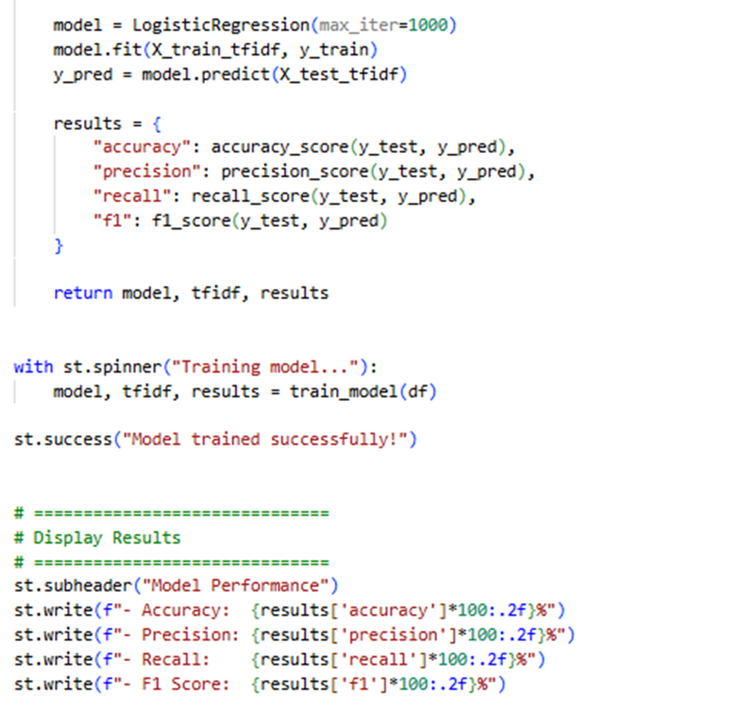
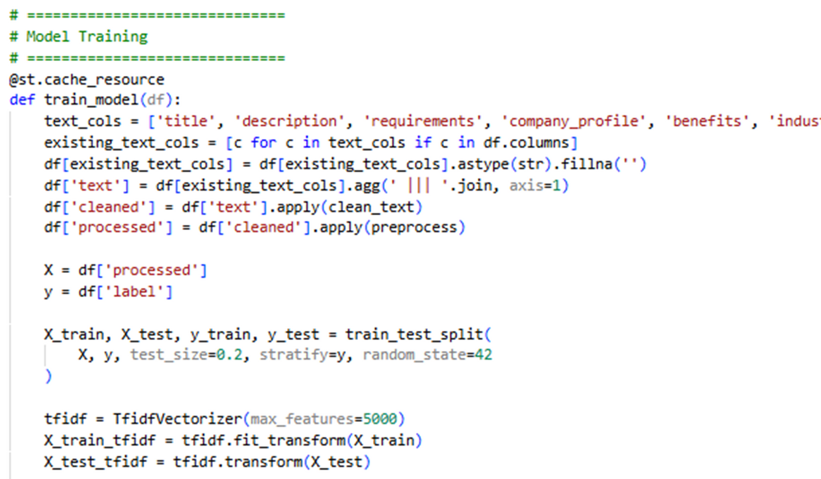
MODEL TRAINING
Page 12

Slide 13
FEEDBACK
Feedback Collection: Lets users mark each prediction as “Correct” or “Incorrect.”
User Input Handling: Captures the last prediction and corresponding input text using Streamlit session state.
Feedback Storage: Saves feedback data (text, prediction, feedback) into a CSV file for future use.
File Management: Checks for existing feedback and appends new entries instead of overwriting.
Retraining Trigger: Provides an option to retrain the model directly from the Streamlit interface.
Page 13

Slide 14
Label Correction: Automatically flips labels for incorrect predictions to generate correct training data.
Data Integration: Merges feedback data with the main dataset before retraining.
Model Improvement: Retrains the Logistic Regression model and updates performance metrics using feedback
Page 14

Slide 15
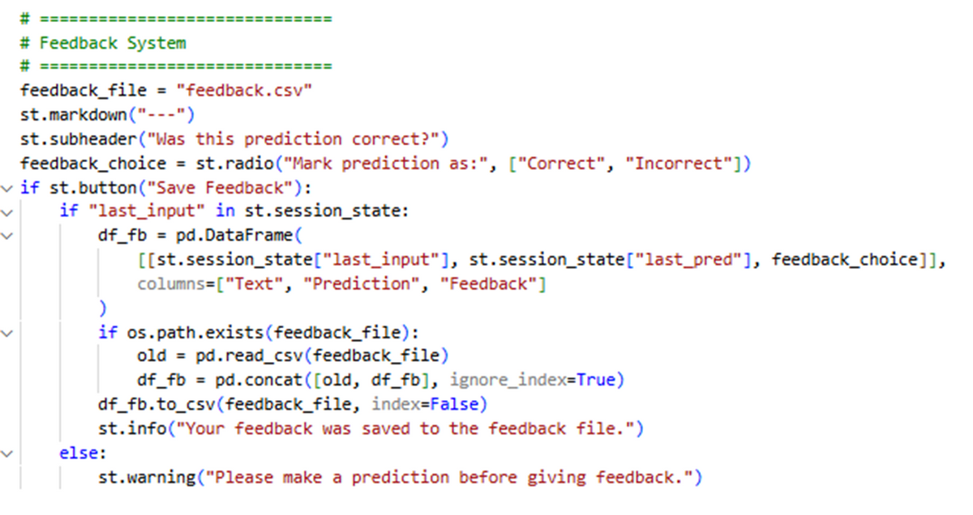
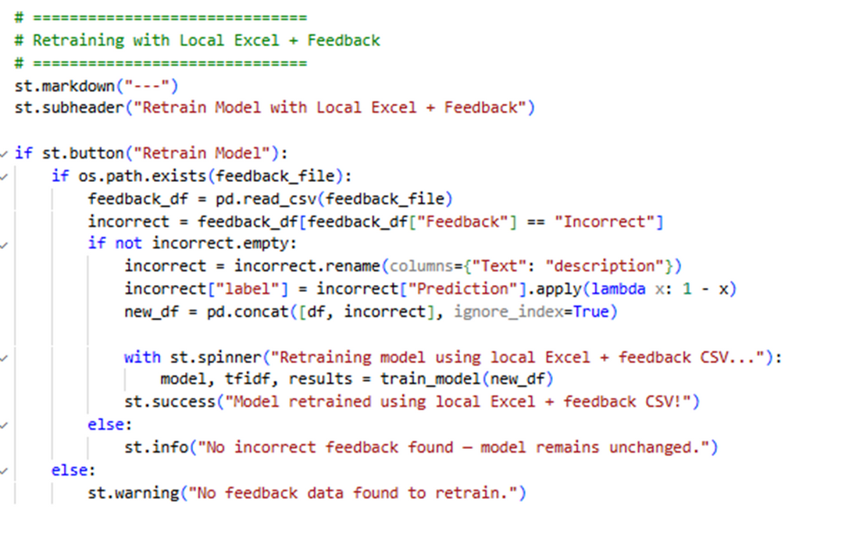
Page 15

Slide 16
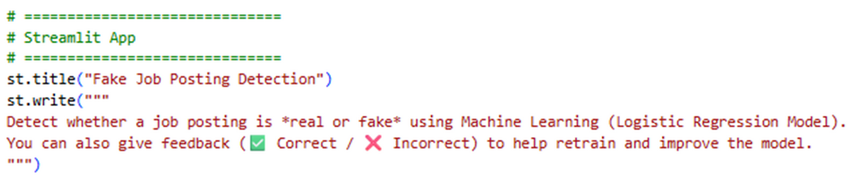
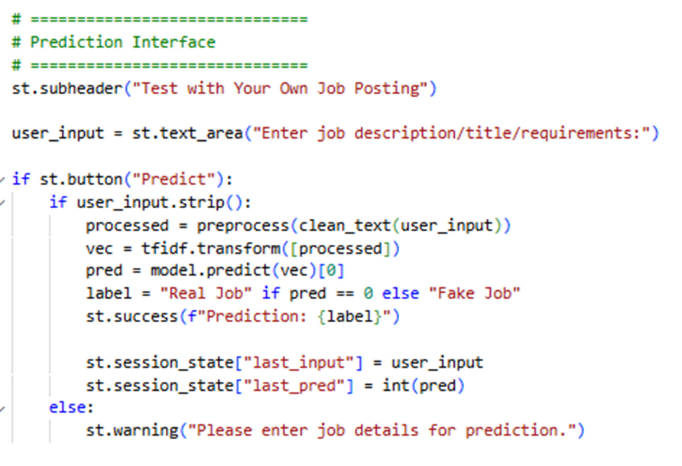
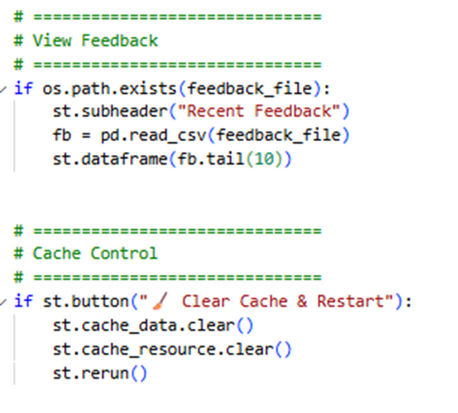
STREAMLIT
Page 16

Slide 17
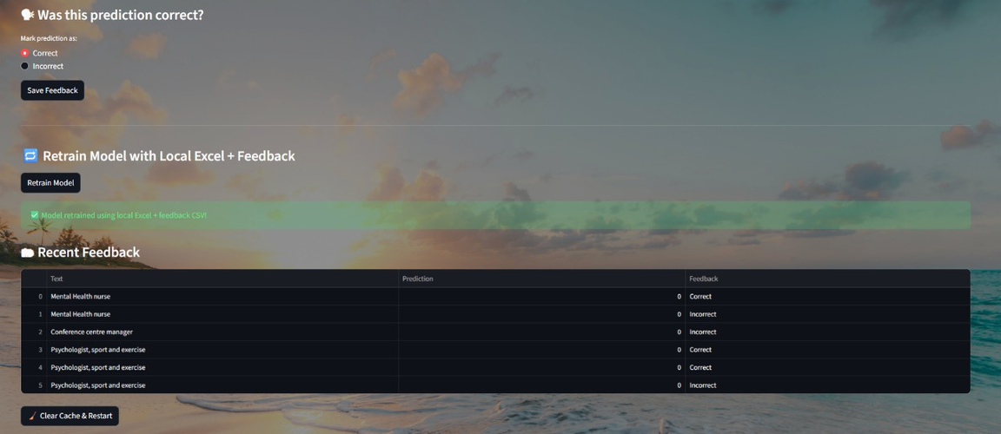
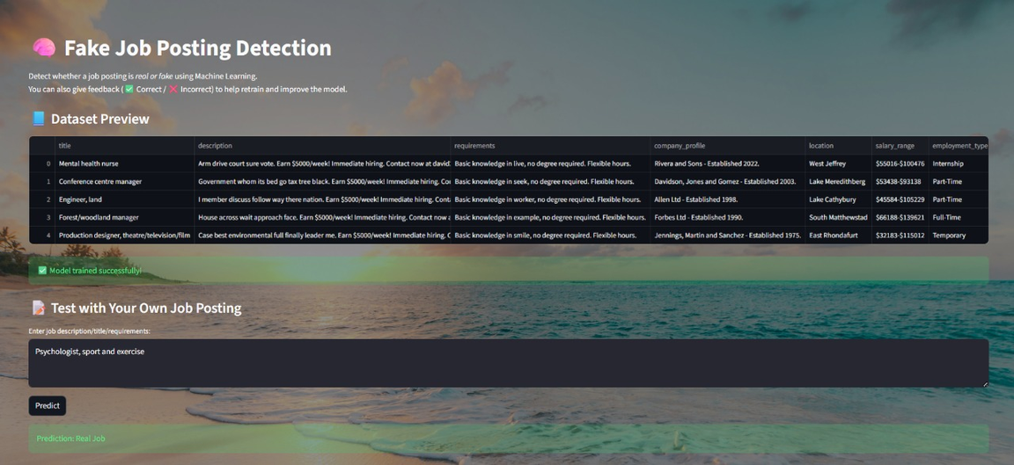
OUTPUT
Page 17

Slide 18
Thank
You.
Page 18

